Slide 1
The Power of Life Insurance
Larger Inheritances. More Control. Less Tax.
>> Leveraging Large IRAs to Create Long-Term, Tax-Free Wealth
[April 9, 2026]
Copyright © 2026 by Ed Slott and Company, LLC

Slide 2
Setting the Stage
Why the opportunity to act
has never been greater

Slide 3
Tax Planning Should Focus on Long-term Outcomes
Larger inheritances. More control. Less tax.
Advisor Takeaways
Large IRAs create a tax problem — It’s a tax waiting to happen
These large IRA balances need to be reduced — and they can be at today’s low tax rates
Life insurance is a powerful solution — exchanging bad assets for good assets
Large IRAs can fund large life insurance policies
Tax-free life insurance can create an ideal wealth transfer vehicle — without the tax complexity and limitations of using IRAs

Slide 4
One Strategy. Three Wins.
When large IRA assets are repositioned strategically, the benefits compound across generations.
Win 1 Your Client + Lock in today’s tax rates + Reduce future RMD exposure + Add lifetime flexibility via cash value and LTC riders | Win 2 Their Beneficiaries + Income-tax-free legacy + Less complexity than inherited IRAs + Greater control over timing and distributions | Win 3 You + Stronger planning conversations + Differentiated positioning + Multi-generational client relationships
Everyone wins: Clients reduce future tax risk and create more tax-free wealth,
while advisors grow their business by delivering solutions that matter.

Slide 5
IMPORTANT: Not Every Client Needs This Strategy
Life insurance as an IRA replacement strategy works best for a specific client profile.
Best Candidates: Large IRA balances ($500K+, especially multi-million) Funds genuinely earmarked for heirs — not needed for lifetime income Insurable — health qualifies them for a policy Long time horizon — this is a multi-year commitment Estate planning goals that go beyond simple beneficiary designation | Not a fit when: Need IRA funds for retirement income IRA balance will likely be consumed during lifetime Uninsurable or in poor health Unwilling to commit to a long-term strategy
The value isn't selling life insurance to everyone.
It's knowing which clients need this conversation — and being the advisor who has it.

Slide 6
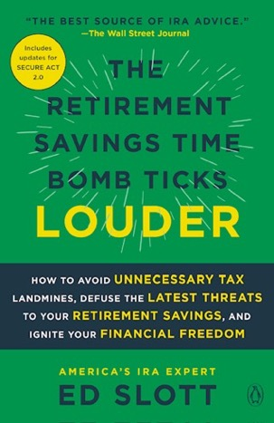
Helpful Client Conversation Tool
“I do not sell life insurance… I am a CPA and tax-planning advisor,
and as a tax advisor I can tell you that the single biggest benefit in the tax code
is the income tax exemption for life insurance.”
— Ed Slott, CPA
Entire consumer chapter in The Retirement Savings Time Bomb Ticks Louder
Written for retirees/pre-retirees
Independent CPA perspective (not insurance sales)
Useful for tax diversification conversations

Slide 7

The Clock is Ticking on Low Rates
Today’s tax rates are among
the lowest in history
…and they have been extended.
….But who knows for how long?
Now is the time to act—locking in these rates for your clients’ benefit helps ensure a tax-optimized future.

Slide 8
The IRA Tax Problem
Large balances. Concentrated risk.

Slide 9
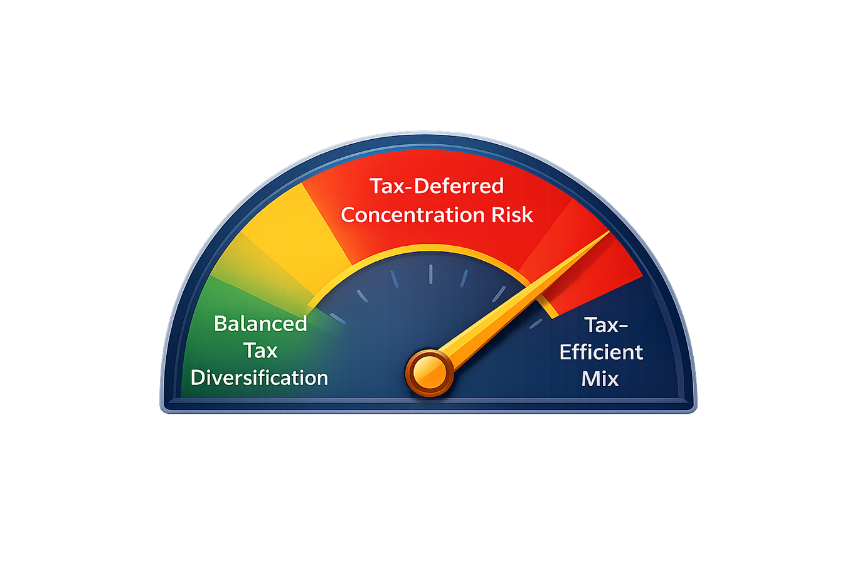
The IRA Problem
Balances are growing dangerously high,
creating future tax risk,
and a lack of diversification.
Taxable RMDs will limit
long-term planning options
and erode IRA balances for clients
and their beneficiaries.
Solution: Use a tax-smart withdrawal strategy.
Life Insurance can play a strategic role.

Slide 10
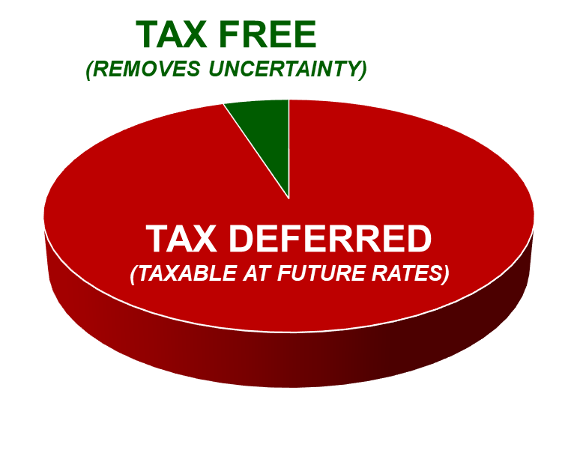
IRA Imbalance: Overweighted Tax-Deferred Accounts
Most retirement savers are overly weighted with traditional IRAs and 401(k)s – building a future tax bill for themselves
and their heirs.
There is not enough
tax risk diversification.
TAX FREE
(REMOVES UNCERTAINTY)
TAX DEFERRED
(TAXABLE AT FUTURE RATES)

Slide 11
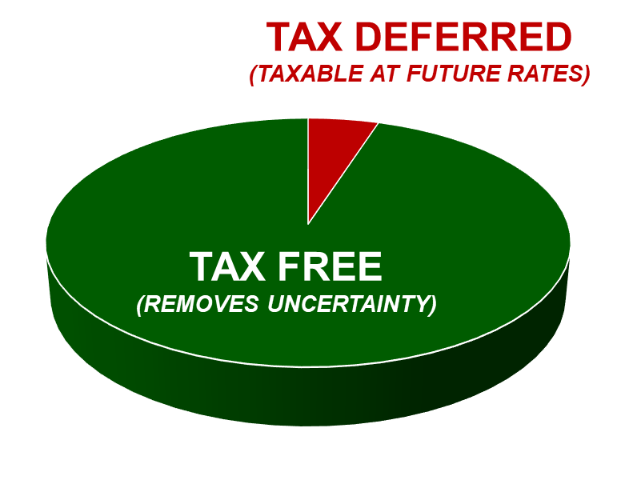
Solution: Reduce IRA Balances While Rates Are Low
Opportunity: Use Roth conversions, life insurance,
and charitable planning to shrink future tax exposure.
Known rates = predictability
TAX DEFERRED
(TAXABLE AT FUTURE RATES)
TAX FREE
(REMOVES UNCERTAINTY)
Action Plan:
Use it, Leverage it, or Lose it to future
(potentially higher) taxes

Slide 12

Which IRAs Are Most Affected?
< $500,000
Largely unaffected
These IRA balances will likely be consumed during a lifetime.
$500,000 – $1MM
Somewhat affected
A good portion of these IRA balances might be consumed during a lifetime, and the remaining funds to beneficiaries spread out over 10 years would not have a major tax impact.
$ Multi-MM IRAs
BIG impact!
A good chunk of these IRA balances may be left to
beneficiaries and often
in trusts.
Urgent!
Planning options for these large IRAs are critical.

Slide 13
The Planning Window
Using today's low rates before the window closes

Slide 14
2026 Tax Rates
Taxable Income Brackets for 2026 Ordinary Income Tax Rates
Marginal Tax Rates | Married Filing Jointly | Single
10% | $0 – $24,800 | $0 – $12,400
12% | $24,801 – $100,800 | $12,401 – $50,400
22% | $100,801 – $211,400 | $50,401 – $105,700
24% | $211,401 – $403,550 | $105,701 – $201,775
32% | $403,551 – $512,450 | $201,776 – $256,225
35% | $512,451 – $768,700 | $256,226 – $640,600
37% | Over $768,700 | Over $640,600
* The top rate is effectively 40.8% for those subject to the 3.8% Medicare surtax on net investment income

Slide 15
History of Top Federal Income Tax Rates By Year
Today’s rates are historically low. That’s the opportunity.
Year | Tax Rate | Year | Tax Rate | Year | Tax Rate | Year | Tax Rate | Year | Tax Rate
1913 | 7% | 1936 | 79% | 1959 | 91% | 1982 | 50% | 2005 | 35%
1914 | 7% | 1937 | 79% | 1960 | 91% | 1983 | 50% | 2006 | 35%
1915 | 7% | 1938 | 79% | 1961 | 91% | 1984 | 50% | 2007 | 35%
1916 | 15% | 1939 | 79% | 1962 | 91% | 1985 | 50% | 2008 | 35%
1917 | 67% | 1940 | 79% | 1963 | 91% | 1986 | 50% | 2009 | 35%
1918 | 77% | 1941 | 81% | 1964 | 77% | 1987 | 38.5% | 2010 | 35%
1919 | 73% | 1942 | 88% | 1965 | 70% | 1988 | 28% | 2011 | 35%
1920 | 73% | 1943 | 88% | 1966 | 70% | 1989 | 28% | 2012 | 35%
1921 | 73% | 1944 | 94% | 1967 | 70% | 1990 | 28% | 2013 | 39.6%
1922 | 58% | 1945 | 94% | 1968 | 70% | 1991 | 31% | 2014 | 39.6%
1923 | 58% | 1946 | 91% | 1969 | 70% | 1992 | 31% | 2015 | 39.6%
1924 | 46% | 1947 | 91% | 1970 | 70% | 1993 | 39.6% | 2016 | 39.6%
1925 | 25% | 1948 | 91% | 1971 | 70% | 1994 | 39.6% | 2017 | 39.6%
1926 | 25% | 1949 | 91% | 1972 | 70% | 1995 | 39.6% | 2018 | 37%
1927 | 25% | 1950 | 91% | 1973 | 70% | 1996 | 39.6% | 2019 | 37%
1928 | 25% | 1951 | 91% | 1974 | 70% | 1997 | 39.6% | 2020 | 37%
1929 | 25% | 1952 | 92% | 1975 | 70% | 1998 | 39.6% | 2021 | 37%
1930 | 25% | 1953 | 92% | 1976 | 70% | 1999 | 39.6% | 2022 | 37%
1931 | 25% | 1954 | 91% | 1977 | 70% | 2000 | 39.6% | 2023 | 37%
1932 | 63% | 1955 | 91% | 1978 | 70% | 2001 | 39.1% | 2024 | 37%
1933 | 63% | 1956 | 91% | 1979 | 70% | 2002 | 38.6% | 2025 | 37%
1934 | 63% | 1957 | 91% | 1980 | 70% | 2003 | 35% | 2026 | 37%
1935 | 63% | 1958 | 91% | 1981 | 70% | 2004 | 35%

Slide 16
Big Picture Retirement Planning Solutions
Ignore RMDs!
Think Maximum! … not Minimum
Instead of RMDs driving distributions…
Let tax planning drive the distribution planning

Slide 17
Ed Slott’s Always Rule:
Always pay taxes
at the lowest rates...
>>> Even if that means paying taxes
BEFORE they are required.

Slide 18
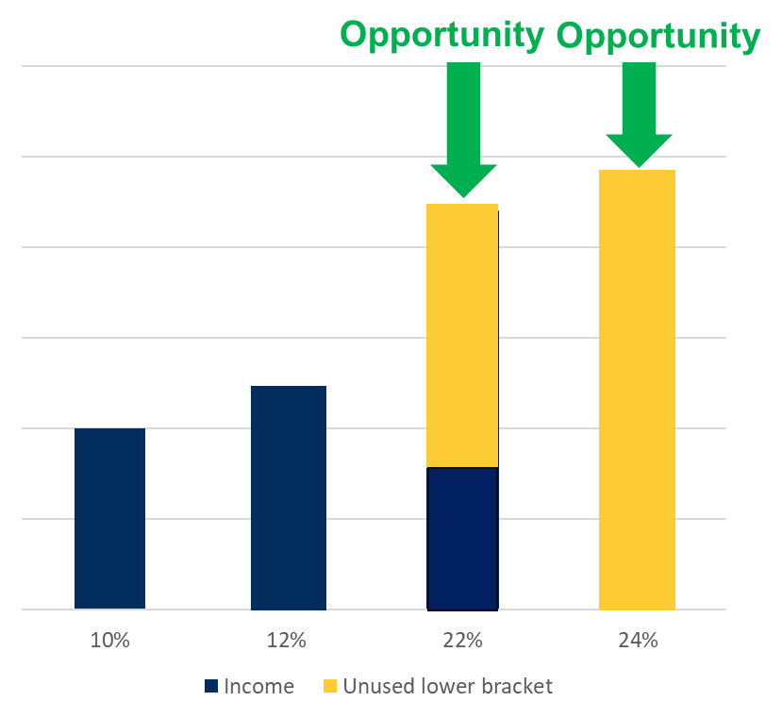
Don’t Waste Lower Tax Brackets
Minimum Mentality:
Only taking what is required, likely resulting in
more taxes long term.
Maximum Mentality:
Use up lower tax brackets every year.
Do not waste them.
Unused lower brackets = lost forever
Resulting in larger tax bills later at likely higher rates.
Think: How much can be withdrawn each year
while using the lower tax brackets 12%, 22%, 24%.

Slide 19
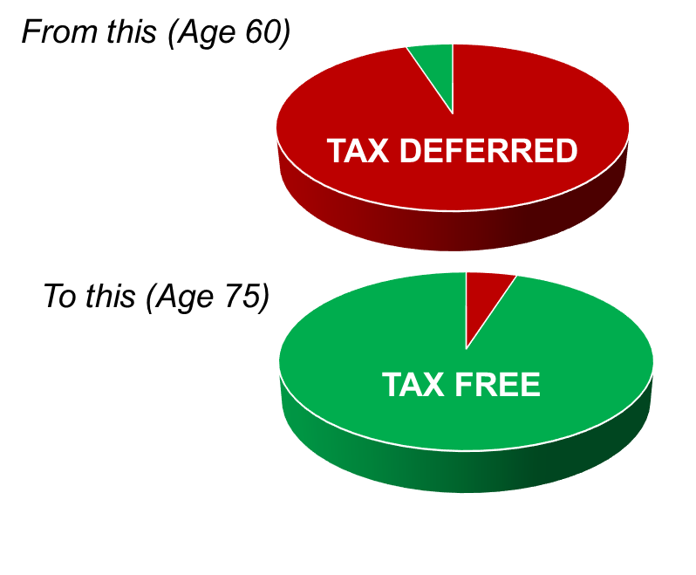
The “Sweet Spot” Tax Planning Window
PROACTIVELY ADDRESS TAX RISK
A 60-year-old today won’t start RMDs until age 75.
Doing nothing for 15 years means:
Bigger IRA → Bigger future tax bill
15 years of low tax brackets wasted
Higher RMDs later → less planning flexibility
The Opportunity:
Use low tax brackets now
Pre-RMD years let you control your tax rate
Once RMDs begin, flexibility disappears —
RMDs must be taken first and
cannot be converted to Roth IRAs
But…RMDs can be used to fund life insurance
Act early. Shrink IRA balances while rates are low.
Annual withdrawals shift the balance
— and lower future taxes.

Slide 20
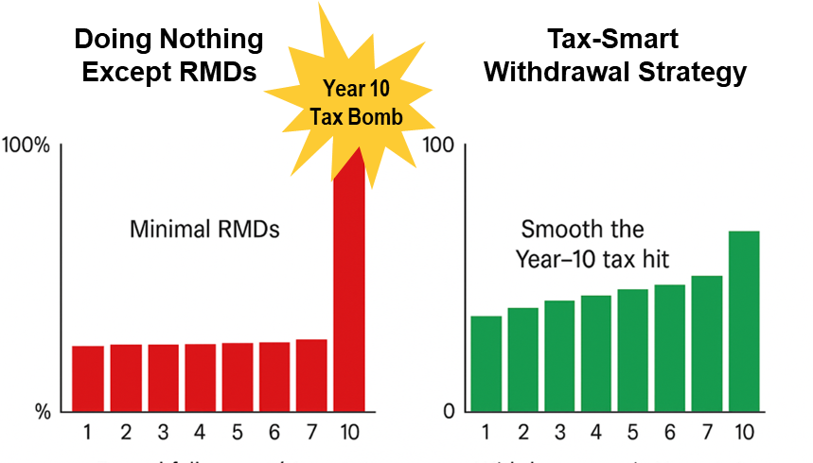
Don’t Let Beneficiaries Waste Low Tax Brackets
PROACTIVELY ADDRESS
INHERITED IRA TAX RISK
Doing the bare minimum (years 1–9 RMD only) means:
Small withdrawals early → huge tax bill in Year 10
Lost opportunity to use lower tax brackets
Steeper overall tax cost over the 10-year window
The Opportunity:
Withdraw more than the required RMD in years 1–9
Use lower brackets early to smooth out the tax impact
Avoid a massive Year-10 “100% RMD” tax spike
Beneficiaries can’t convert — but they can plan.
Front-loading withdrawals lowers total taxes.

Slide 21
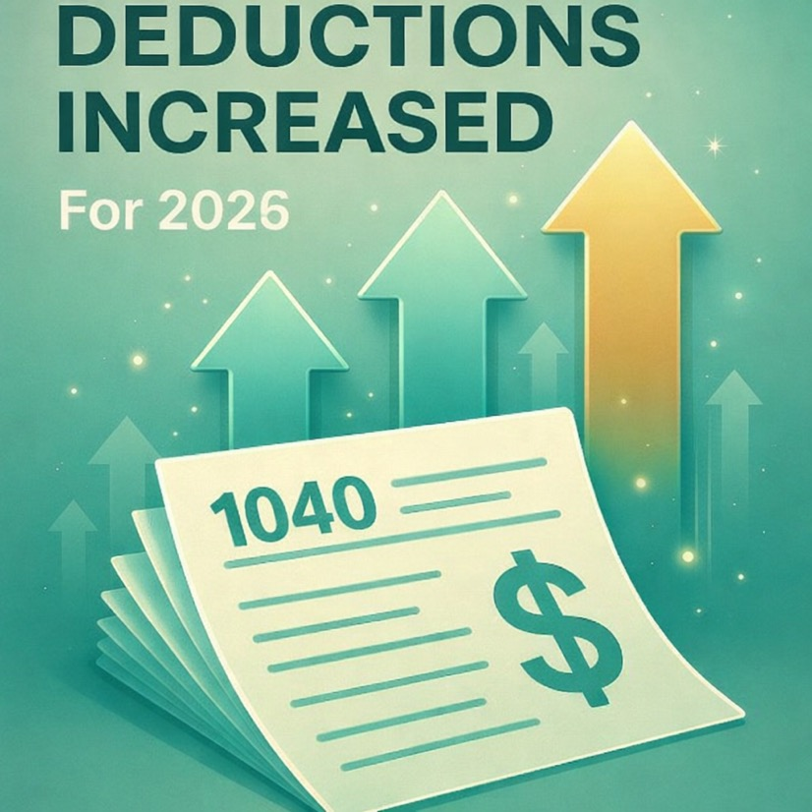
OBBBA: The Window Just Got Bigger
New deductions quietly expand
IRA withdrawal capacity
The One Big Beautiful Bill Act extended today's low tax rates —making the planning window for IRA withdrawals longer and more valuable.
Key provisions that directly affect IRA withdrawal strategy:
Standard deduction increased —
$32,200 MFJ / $16,100 Single for 2026
New $6,000 senior deduction for age 65+
(up to $12,000/couple)
SALT deduction increased to $40,400 for 2026
Bottom line: More deductions =
lower net cost to pull money out of an IRA.
That's more runway to fund life insurance at today's rates.

Slide 22
What This Means for Your Clients
Higher Deductions
Lower Taxable Withdrawals
More Efficient Insurance Funding
Higher Deductions
Lower Taxable Withdrawals
More Efficient Insurance Funding
OBBBA doesn't change the strategy. It makes it cheaper to execute.
For clients age 65+ filing jointly, total 2026 deductions could reach $47,500 —
meaning a significant portion of IRA withdrawals used to fund life insurance premiums
can be offset by these deductions.

Slide 23
Why IRAs No Longer Work for Wealth Transfer
The SECURE Act changed everything

Slide 24
SECURE ACT
Setting Every Community Up for Retirement Enhancement Act of 2019
SECURE Act is the GAME CHANGER!
Don’t let the impact of other recent tax laws overshadow this
► Old law:
Stretch IRA for all designated beneficiaries – individuals named on the IRA or plan beneficiary forms, and qualifying trusts
◉ 2020 law:
Stretch IRA was eliminated – replaced with a 10-year payout for most non-spouse beneficiaries, except for “Eligible Designated Beneficiaries”

Slide 25
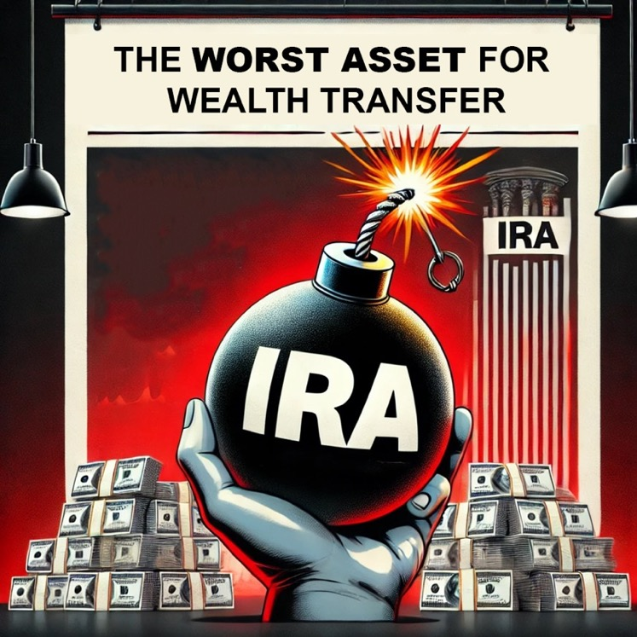
Why IRAs Are Now The Worst Asset for Wealth Transfer
The SECURE Act makes IRAs one of
the worst assets for wealth transfer & estate planning.
Leaving IRAs to trusts? Even worse!
The tax-deferred growth in IRAs must be squeezed into a short 10-year window
after death—resulting in a massive tax
time bomb.

Slide 26

SECURE Act: Long-term Game Changer
DOWNGRADED: Trusts
Conduit trusts no longer work
Why? All funds must be withdrawn from the inherited IRA by the end of the 10th year after death, but RMDs could be required for years 1-9 if death occurs after the required beginning date (RBD).
After the 10 years:
100% RMD at that point.
All inherited IRA funds would be released to the beneficiaries, nullifying any further trust protection – exactly the opposite of what the client wanted!

Slide 27
SECURE Act: Long-term Game Changer
DOWNGRADED: Trusts
Discretionary Trusts (Accumulation Trusts)
These will still work, but at a potentially heavy tax cost.
Years 0→10
Trustee can spread payouts to the trust
(or trust beneficiaries) over the 10 years
After 10 years, someone will pay the tax on the
entire IRA balance:
  Either the trust, at high trust tax rates (if the funds are held to be protected); or
  By the individual beneficiaries at their own rates – but then the funds are no longer protected in the trust

Slide 28
SECURE Act: Long-term Game Changer
DOWNGRADED: Traditional IRAs
Traditional IRAs are now the worst assets to leave to a trust.
Post-death control and protection would come at too high of a tax cost.
Roth IRA Solution:
Roth IRAs will work better here; no trust tax when the funds go to the trust or to the trust beneficiaries.
Life Insurance (an even better solution):
Life insurance is a better, more flexible and customizable asset to leave to a trust
Life insurance can work better for funding trusts for
special needs beneficiaries

Slide 29
The Life Insurance Solution
Exchanging bad assets
for good assets

Slide 30
THE IRA PROBLEM
The Larger the IRA
The Larger the Future Tax Exposure
↓
THE OPPORTUNITY
Strategic Repositioning
Can Convert Taxable Assets
Into Tax-Efficient Legacy Assets

Slide 31
Planning Solutions to Reduce Lifetime Tax Bills
Reduce IRA Balances – when tax rates are low
Roth Conversions
Take control of
future taxes
Life Insurance
Moves to the top of the solutions list, replacing IRAs
Charitable Tax Planning with IRAs
QCDs
(Qualified Charitable Distributions)
CRTs
(Charitable Remainder Trusts)

Slide 32
The tax exemption for life insurance is the single biggest benefit in the tax code.
“Life insurance is not only the single biggest benefit in the tax code,
but it is also the most cost-effective way to leverage a large IRA.”
— Ed Slott, CPA
The SECURE Act makes life insurance a
much better estate planning vehicle than an IRA.
Solution:
Draw down IRA funds at the lowest possible tax cost.
Then move any of those funds earmarked for beneficiaries to life insurance.

Slide 33

Ed Slott’s Life Insurance Replacement Plan
Pay down IRA during lifetime
Pay tax at current low rates, over a number of years
(but don’t do this before age 59 ½ - a 10% early distribution penalty
will apply)
After-tax funds can be used to purchase life insurance
If a trust is needed, the life insurance can be paid to an insurance trust (ILIT)
Reduces current income tax by eliminating RMDs on IRA
funds withdrawn

Slide 34

Three Outcomes Clients Care About
Larger Inheritances
More Control
Less Tax

Slide 35
Why Life Insurance Now Ranks Higher
▲ Upgrade: Life insurance moves to the top of the list as an estate and tax planning vehicle for the largest IRAs.
▼ Downgrade: IRA trusts less effective post-SECURE Act.
► Life insurance can replace the benefits of the stretch IRA and IRA trusts.
More flexibility
  Life insurance is a better, more flexible and customizable asset to leave to a trust
  Life insurance can work better for funding trusts for special needs beneficiaries
  Life Insurance is a more workable planning vehicle for second marriages –
  to fund QTIP trusts

Slide 36

Post-SECURE Act Advantages
More tax efficient
  Life insurance death benefit proceeds are income tax-free to beneficiaries
  Life insurance can also be estate tax-free – set up outside the estate
Life insurance provides more long-term certainty and reliability
IRA tax rules are constantly in flux.
It’s more likely Congress will change the IRA tax laws
than life insurance benefits.

Slide 37
Life Insurance Solves the IRA Trust Tax Problem
Benefits of a Life Insurance Replacement Plan - Estate Planning
The SECURE Act eliminated the stretch IRA for most non-spouse beneficiaries
– Including most trusts
Exception: “Eligible Designated Beneficiaries” (EDBs) still get the stretch IRA
Life Insurance is now the most flexible and tax friendly
asset to leave to a trust when post-death control is needed
2026 Trust Tax Rates
10% | $0 - $3,300
24% | $3,301 - $11,700
35% | $11,701 - $16,000
37% | Over $16,000
Life Insurance can avoid high trust taxes for heirs
if a trust is the beneficiary:
  SECURE Act – Most trusts funded with IRAs or Roth IRAs
  will be subject to the 10-year payout rule after death.
  Life insurance paid to the trust can remain in the trust,
  or be paid out to trust beneficiaries according to the wishes
  of the client – without worrying about all the IRA RMD rules!

Slide 38

Simplicity Matters
Less tax law complications
No RMDs
No complex tax rules
  No rigid stretch IRA trust provisions
  No IRA custodian issues
No trust tax on the life insurance proceeds paid to the trust
(earnings on the proceeds though will be taxable)

Slide 39
Flexible Wealth Transfer Structure
Life insurance trusts can be customized to simulate the stretch IRA
over any payout period desired
  Trustee can have the power to keep the funds protected in the trust without having to incur a trust tax (other than on annual earnings); or
  The trustee can invade the trust for beneficiaries
  No worry about who the beneficiary is. IRA payouts are based on the type (the category) of the beneficiary.
Life insurance provides leveraged wealth transfer
More funds can go to the eventual beneficiaries and with less tax than if the IRA was left directly to the beneficiaries or to an IRA trust

Slide 40

This Isn’t Just About Legacy
It’s About Access, Control & Flexibility
Clients tune in to one station: WIIFM
“What’s In It For Me?”
Not just death benefit.
Not just tax-free inheritance.
Control during life
Flexibility after death

Slide 41

What’s In It for the Client?
ACCESS
Cash value can be accessed for any reason — income tax free (if structured properly).
That provides peace of mind for clients who may need access to funds.
Note: Cash value builds over time. Not as much in the early years.
RETIREMENT INCOME
Life insurance can double as a tax-free retirement account because funds can be accessed during lifetime.
It can create additional tax-advantaged dollars once other retirement plans are maxed out.
TAX CONTROL
Cash value can be used instead of withdrawing taxable IRA funds — lowering taxes in retirement.
Distributions will not trigger stealth taxes.
Helps manage tax brackets — avoiding unnecessary jumps into higher brackets.

Slide 42

What’s In It for the Client?
PROTECTION WHEN IT’S NEEDED MOST
Long-term care riders – HUGE lifetime benefit
Reduces anxiety about where care dollars come from
Avoids forcing IRA withdrawals at the worst time
Helps prevent the “widow’s penalty” tax spike

Slide 43
After Death: Where Life Insurance Outperforms IRAs
Life insurance can help surviving spouses and other beneficiaries who need to access IRA funds in excess of the RMD amount.
Taking tax-free life insurance instead of taxable IRA funds can help keep AGI
(adjusted gross income) lower.
This may reduce exposure to AGI-based “stealth taxes.”
IRA Taxable Forced liquidation timing Higher AGI (potential stealth taxes) | LIFE INSURANCE Tax-free No 10-year rule No forced distribution No AGI impact Full timing control

Slide 44
Death Benefits
Life Insurance Can Help Minimize Taxable IRA Withdrawals for Non-Spouse IRA Beneficiaries
Use Life Insurance to Enhance the Inherited Roth IRA Benefit:
Using life insurance proceeds can allow inherited Roth IRAs to last longer and accumulate tax-free
(up to the end of the 10 years after death).
Tax-free life insurance benefits can also be used by non-spouse beneficiaries
to convert their own IRAs to Roth IRAs.
Caution: Inherited IRAs cannot be converted to inherited Roth IRAs.
Life Insurance Can Offset the Tax Impact of the SECURE Act 10-Year Rule
Having tax-free life insurance funds available may allow beneficiaries to:
Keep inherited IRA withdrawals to a minimum early on
Use lower tax brackets first
Avoid large forced withdrawals at the end of the 10-year period

Slide 45
Avoiding the
Widow’s Penalty
Leverage large IRAs now
to minimize the most overlooked penalty

Slide 46
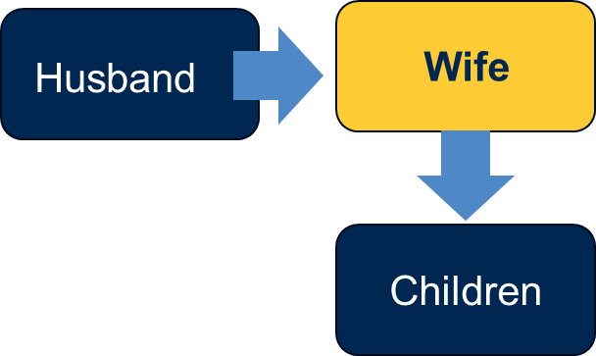
The Overlooked Horizontal Wealth Transfer Advisors Face First
Most planning conversations focus on transferring wealth down to the next generation.
But the first transfer most advisors will face is horizontal —
to the surviving spouse, not the children.
$54 Trillion
Wealth Transfer Path
Women live longer than men, so many wives
will inherit from their husbands.
$54 trillion will pass first to surviving spouses
(mostly women).
95% of spousal heirs will be women.
Cerulli Associates, 2024.
Widows outlive husbands by 4–12 years on average.
UBS 2024; CDC life expectancy data.
Husband
Wife
Children

Slide 47
The Overlooked Horizontal Wealth Transfer Advisors Face First
Empowering Widows Before & After
the First Spouse Dies
Many widows are unprepared for the financial responsibility of the death of a spouse.
56% of married women defer long-term financial decisions to their husbands.
98% of widows regret not being more involved earlier.
UBS “Own Your Worth” study; Thrivent 2024 widows survey.
Advisors can help before and after this transition.
80% of widows
switch financial advisors
after the husband’s death
— if they weren't involved.
(BlackRock / Cerulli data.)

Slide 48
The Widow’s Penalty: Same Income, Higher Tax Rate
Married Filing Jointly
Income: $400,000
Marginal Rate: 24%
Widow (Single)
Income: $400,000
Marginal Rate: 35%
Assume a married couple has joint 2026 taxable income of $400,000,
the marginal tax rate (on the last dollars) of 24%
After the husband dies, the widow will have approximately the same income (based on the same RMD amounts), BUT since she will now pay tax at single rates (beginning in the year after death)
her marginal tax rate would jump to 35%! - That’s a 46% tax increase!!! - from 24% to 35%
That’s a BIG tax increase, and that will increase over time as RMDs grow larger.
That’s the Widow's Penalty.

Slide 49
Taxable Income Brackets for 2026 Ordinary Income Tax Rates
Compare Married vs Single for Widow’s Penalty Context
Same Income, Higher Tax Rate
Marginal Tax Rates | Married Filing Jointly | Single
10% | $0 – $24,800 | $0 – $12,400
12% | $24,801 – $100,800 | $12,401 – $50,400
22% | $100,801 – $211,400 | $50,401 – $105,700
24% | $211,401 – $403,550 | $105,701 – $201,775
32% | $403,551 – $512,450 | $201,776 – $256,225
35% | $512,451 – $768,700 | $256,226 – $640,600
37% | Over $768,700 | Over $640,600
The table highlights key marginal tax brackets.
The 24% marginal tax rate applies to taxable income from $211,401 to $403,550 for Married Filing Jointly.
For Single filers, higher income levels are emphasized, including the 35% bracket, which applies from $256,226 to $640,600.
* The top rate is effectively 40.8% for those subject to the 3.8% Medicare surtax on net investment income

Slide 50
Why Reposition Before the First Spouse Dies
Last Year
for Married
Tax Rates
Planning Opportunity:
Final Married-Year Filing Window
If a spouse dies during the year, IRA distributions taken in that year can still use married-joint rates for that calendar year.
This may be the last opportunity to take advantage of the wider married brackets— whether repositioning funds to Roth IRAs or funding permanent life insurance.
Include any planned IRA income on the
final married-joint return.
A couple can decide to reposition IRA assets at today’s lower married rates — whether through Roth conversions or funding tax-free life insurance strategies – or both.
Avoids “the widow’s penalty” where the surviving spouse will pay higher taxes (at single rates) on lower income

Slide 51

Tax-Free Strategies for the Surviving Spouse
Tax insurance for the widow:
Repositioning IRA assets can be a gift to the surviving spouse —
whether through Roth strategies or permanent life insurance.
KEY TAX ADVANTAGES OF REPOSITIONING:
No lifetime RMDs for a surviving spouse (Roth rollover scenario)
Tax diversification — more assets protected from future tax increases
Funds can be accessed without raising taxable income,
helping manage:
– IRMAA
– Medical expense deductions
– Senior deduction
– 3.8% net investment income tax

Slide 52
Roth IRAs vs. Life Insurance
When each works best

Slide 53
Roth IRAs vs Life Insurance
Establishment
ROTH IRA Easier to set up Can be done instantly Anyone can qualify (assuming income is under the limits for making contributions) Conversions unlimited | LIFE INSURANCE Requires underwriting Takes planning time Not everyone insurable

Slide 54
Roth IRAs vs Life Insurance
Funding & Eligibility Considerations
ROTH IRA Always included in estate Contributions income-limited However, “backdoor” workaround exists Annual contribution limits (takes longer to build substantial wealth, especially later in life) Earned income requirement to contribute (W-2 or self employment earnings) Conversions unlimited, but taxable | LIFE INSURANCE Can be excluded from estate Generally, no income limits No contribution limits

Slide 55
Roth IRAs vs Life Insurance
Lifetime Access
ROTH IRA Easier to access, both during life and after death When Roth funds are qualified (being held for 5 years , and until age 59 ½), all Roth funds can be withdrawn tax and penalty free. Non-qualified Roth funds (withdrawn before age 59 1/2 , for example) can be subject to a 10% early distribution penalty. | LIFE INSURANCE Can include tax and penalty free lifetime access to cash value and policy loans, but that generally takes more time to set up than simply withdrawing from a Roth IRA. In addition, it will take more time for cash-value buildup to be available in a policy.

Slide 56
Roth IRAs vs Life Insurance
Death Benefit
ROTH IRA No death benefit (other than the inherited amount). | LIFE INSURANCE Has death benefits from inception of the policy.

Slide 57
Roth IRAs vs Life Insurance
RMD Treatment
ROTH IRA Roth IRA have no lifetime RMDs, but Roth beneficiaries do. Inherited Roth IRA funds will eventually be forced out through post-death RMDs. | LIFE INSURANCE No RMDs

Slide 58
Roth IRAs vs Life Insurance
Trust Funding
ROTH IRA Complex IRA trust tax rules 10-year distribution rule Still subject to RMD structure | LIFE INSURANCE Not subject to IRA tax rules No trust RMDs More estate planning flexibility

Slide 59
Advanced Applications
Business, charitable, & complex planning situations

Slide 60

Life Insurance — Business Benefits
IRA funds can be leveraged for Business Succession Planning
Key Person Life Insurance
Stock Buyouts
Employee Benefits

Slide 61
Life Insurance for Special Situations
1. Large IRAs / large estates
To fund trusts
2. QTIP trusts – Second marriage situations
Insurance for all parties after-death
3. To replace or simulate the stretch IRA
Eliminated under the SECURE Act for most beneficiaries
4. Charitable planning and CRTs
5. Special needs / supplemental needs trusts
“When you hit a wall, life insurance is
the answer.”
— Ed Slott, CPA

Slide 62

Charitable Planning
  IRAs are the best assets
  to give to charity
  And those gifts
  can be leveraged
  with life insurance

Slide 63
Charitable Remainder Trusts (CRTs)
Coupled with Life Insurance
Upside:
Best for the larger IRAs – if coupled with life insurance
If your client is charitably inclined, CRTs can simulate the stretch IRA, with yearly payouts to beneficiaries for a term of years or life
Tax-free to CRT – no income tax on the transfer to the CRT
Estate tax deduction based on time period

Slide 64
Charitable Remainder Trusts (CRTs)
Coupled with Life Insurance
Downside:
Funds go to charity after the beneficiary dies, but if the beneficiary is in poor health,
funds may go to the charity earlier than planned
  However - the funds can be replaced tax-free with life insurance on the beneficiary
There is no payout to a successor beneficiary
The longer the beneficiary lives and receives payments from the CRT, the greater the CRT
benefit
Won’t work for very young beneficiaries; they won’t satisfy charitable requirements when a charity has to wait too long for their money

Slide 65
The Power of Life Insurance
Considerations & Drawbacks
Only for funds specifically earmarked for beneficiaries – or to build cash value for lifetime use
This is a long-term strategy that must be committed to – clients need to understand this
Limited lifetime access:
This strategy assumes the IRA funds will not be needed during lifetime
(which is likely the case for large IRAs); other (non-IRA) funds will need to be available for lifetime use.
However, policies may provide access to funds via policy loans or enhanced lifetime benefits for healthcare emergencies
Not everyone is insurable
Alternative: Annuities may provide lifetime, long-term care and death benefits
without underwriting required

Slide 66
Action Steps
Use it. Leverage it. Or lose it.

Slide 67

The Power of Life Insurance
Time for an Upgrade!
The old IRA plan won’t work anymore for tax-efficient wealth transfer
Change the vehicle!
Upgrade to a Limo –
a Life Insurance Limo
Gain the 3 Big Benefits
Every Client Wants:
Larger Inheritances
More Control
Less Tax

Slide 68

Use it. Leverage it. Or lose it.
Don’t sit there admiring a large IRA.
Help clients do something with it now.
Use it.
Leverage it.
Or lose it.
Life insurance may be
the most underutilized strategy
to protect large retirement balances from being exposed to potentially future higher tax rates.

Slide 69

Those who own the most, sell the most.
Life Insurance Law for Insurance Professionals:
Those who
own the most,
sell the most.
Believe in
what you sell!

Slide 70
Ed Slott’s Always Rule:
Always pay taxes
at the lowest rates...
Even if that means paying taxes
BEFORE they are required.

Slide 71
What to Do Monday Morning
Your 6-Step Implementation Checklist
WHERE TO START
Step 1 — Identify the right clients
Pull your book. Flag clients with IRAs over $500K — especially $1M+. These are your candidates.
Step 2 — Confirm their tax bracket trajectory
Project their RMDs forward. Are they heading into 32%, 35%, or 37% territory?
The bigger the future bracket, the bigger the opportunity.
Step 3 — Evaluate Roth conversion capacity first
How much room is left in the 22% and 24% brackets? Roth conversions are the first tool.
Life insurance handles what Roth can’t.

Slide 72
What to Do Monday Morning
Your 6-Step Implementation Checklist
HOW TO EXECUTE
Step 4 — Assess insurability
This strategy requires underwriting.
Identify candidates while they're still healthy. Don't wait until health changes the math.
Step 5 — Model the IRA-to-premium conversion
What can they withdraw annually at current rates?
What death benefit does that fund? Run the numbers. The math is the conversation opener.
Step 6 — Coordinate with their CPA
The withdrawal strategy affects their tax return.
Loop in the CPA early — this is a team play, and it positions you as the quarterback.

Slide 73
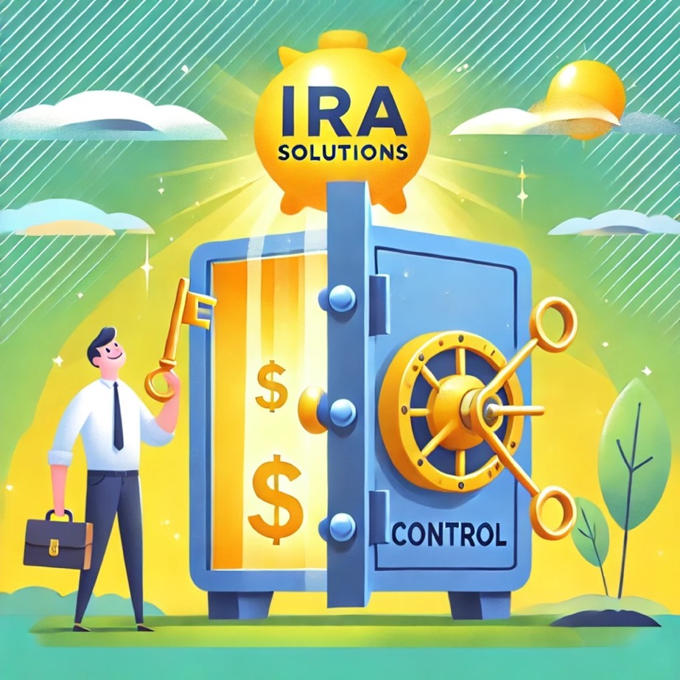

A BETTER Plan
Take Control of Your Clients’ IRAs Now
Start reducing IRA balances now
while tax rates are low:
Roth Conversions:
Shift to tax-free growth.
Life Insurance:
Create a tax-free legacy.
Charitable Planning:
Minimize taxes while maximizing impact.
Don’t wait for the tax time bomb to explode!
Updated 2/26/26

Slide 74


AGENDA: Your 2026 Retirement Tax Checklist
Advisor Action Plan
Your Opportunity Map to
lock in historically low tax rates
+ transform client outcomes!
Copyright © 2026 by Ed Slott and Company, LLC
Notes:
“If you want a simple summary checklist of the opportunities we covered today,
you can scan this and get a free copy.

Slide 75

$500 OFF
PROMO CODE:
PRUDENTIAL-LI
Expires April 23, 2026
Ed Slott and Company’s Exclusive 2-Day IRA Workshop
Instant IRA Success
July 9th to 10th, 2026, New York, NY
New York Marriott at the Brooklyn Bridge
Featuring the latest retirement tax law changes in effect now, including SECURE Act, SECURE Act 2.0, and OBBBA! Register Now
Register at irahelp.com/2-day
Notes:
“If you want to go deeper on these strategies and become the go-to tax advisor in your market,
join us at the 2-Day Workshop.

Slide 76
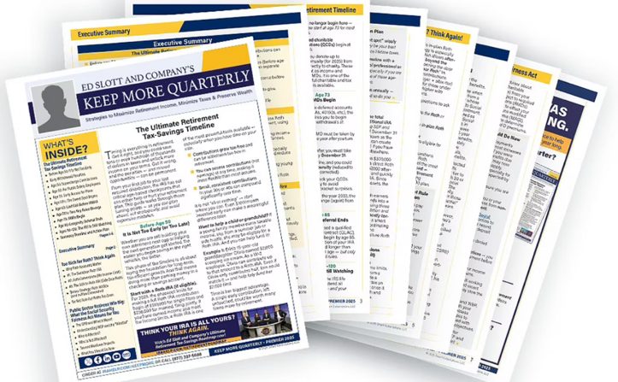
Additional Resources: Tools to Grow Your Expertise & Client Impact
Ed Slott’s IRA Advisor
Monthly IRA case studies and tax law insights.
Social Security Advisor
Claiming, coordination, and income-timing strategies.
NEW! Keep More Quarterly
Client-ready retirement tax newsletter to customize & build relationships.
irahelp.com/newsletter
Notes:
“For ongoing education, here are some of the newsletters we publish.
These are tools advisors use to stay sharp and keep clients informed.”

Slide 77
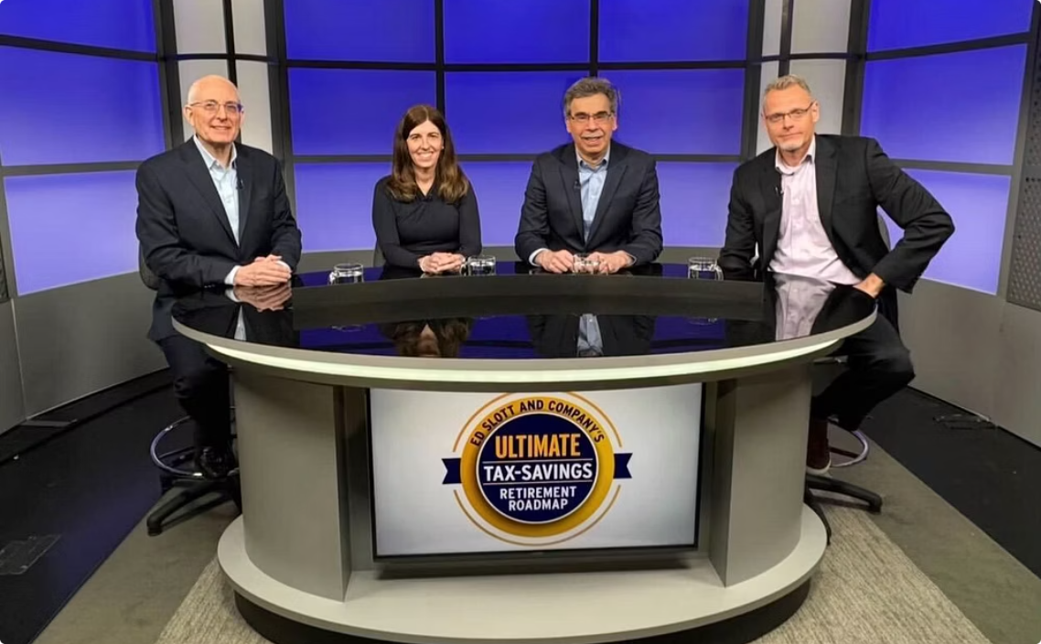
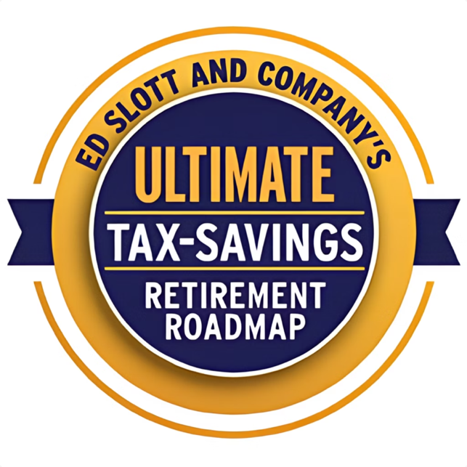
Free 40-Minute Consumer Special
irahelp.com/RetirementRoadmap

Slide 78

Thank You!

